Slide 1


Paignton Zoo Walk through
A resource for teachers with SEN learners

Slide 2
A Note for Teaching Staff
How to use this power point
In this PowerPoint we have included various different aspects of a day at the zoo.
It is designed to be fully editable so you can tailor it to your day.
Some parts may not be applicable to your visit, you can hide the slides that do not apply (including this one).
On some slides, there are various options shown, you are welcome to delete and enlarge pictures where appropriate if you wish to do so.
You can find what's applicable to your visit by looking at the itinerary that will be emailed to the school up to 2 weeks before your visit.
Please be advised that although we do our very best to stick to the plan, sometimes things happen out of our control, and we may need to change them.
We hope you find this PowerPoint useful; we are always open to suggestions on how we can make it better.

Slide 3
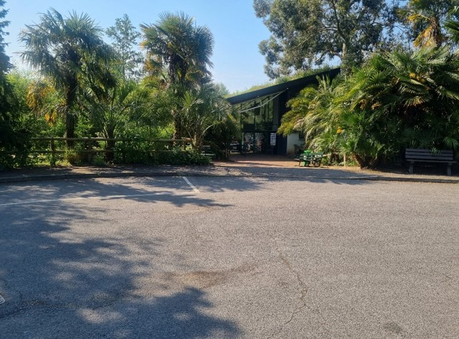
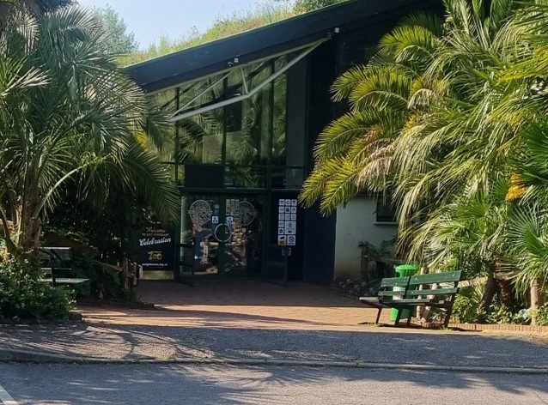
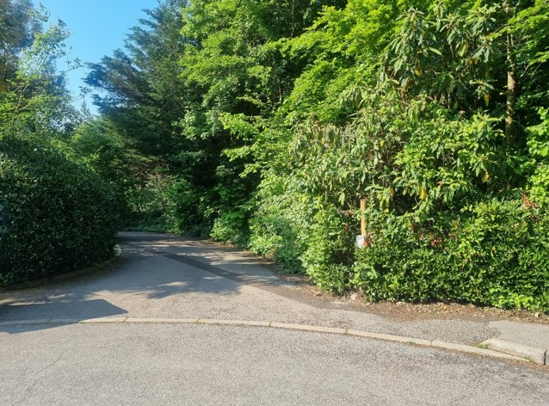
Arrival
When you arrive at the zoo your coach or minibus will park at the front entrance of the zoo.
Here is the main entrance, It can sometimes be busy with people visiting for the day.
Schools have a special entrance; it is just to the side of the main entrance. One of our educators will take you into the zoo.

Slide 4
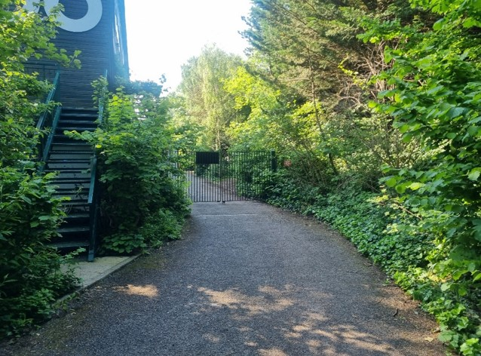
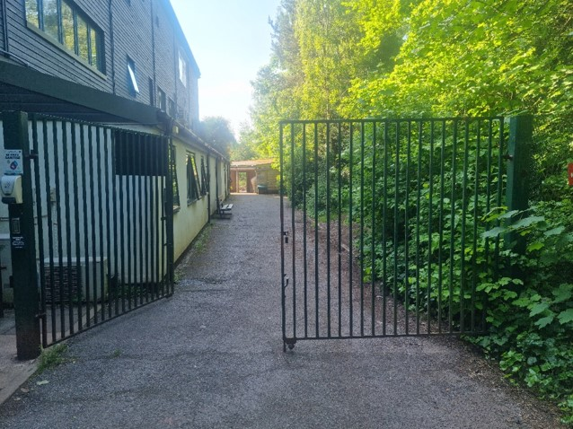
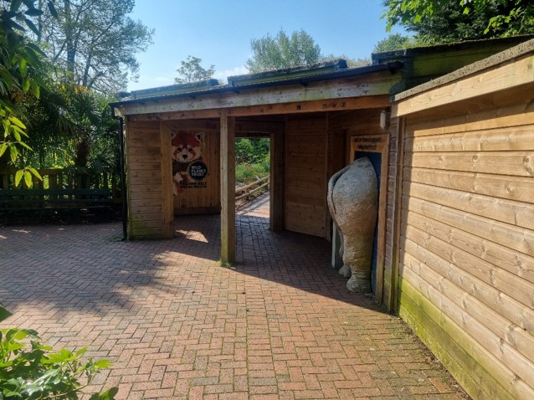
You will walk down the small drive towards the gate.
Our educator will open the gate, and you will carry on into the zoo.
You will then go through the archway, past the rhino’s bottom and past the red panda painting.

Slide 5
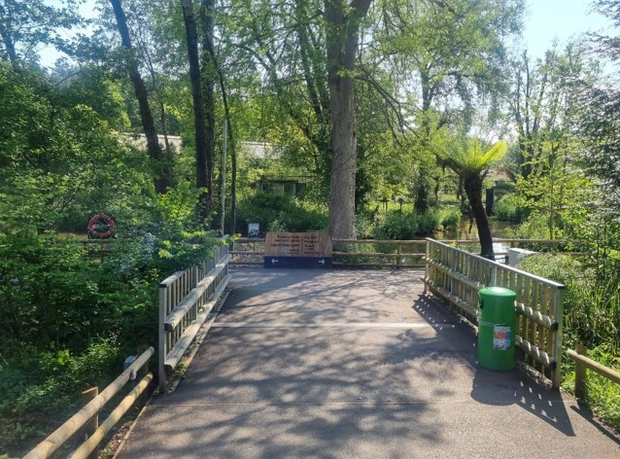
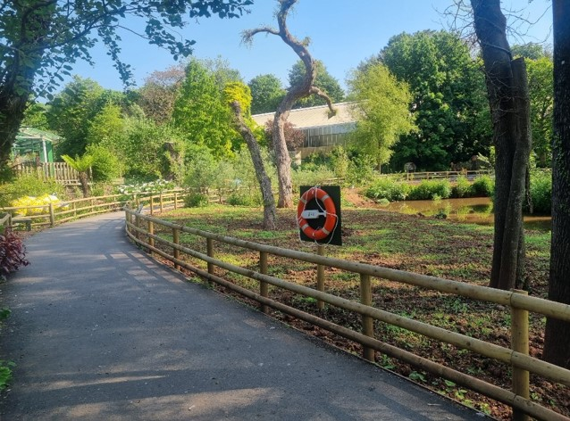
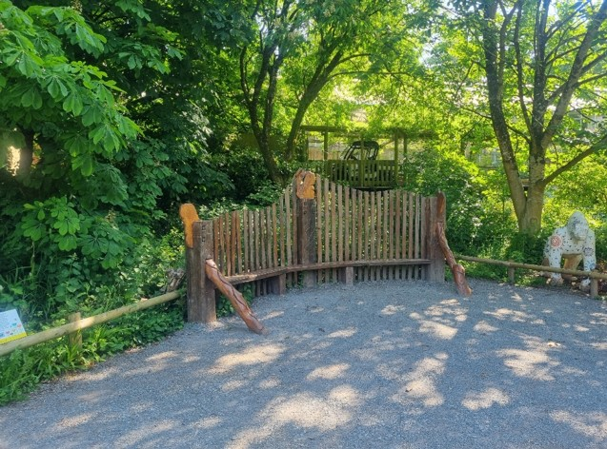
Once through the archway You will cross over the small bridge and turn left.
Follow the path around.
You will stop for a welcome at Gibbon view. Here one of our educators will tell you any zoo news.

Slide 6

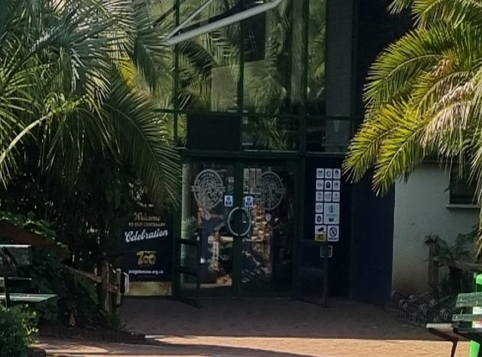
Self led Arrival (for groups smaller than 10)
When you arrive at the zoo your coach or minibus will drop you at the front entrance of the zoo.
Here is the main entrance, It can sometimes be busy with people visiting for the day.
Walk through the doors to enter the main building.

Slide 7
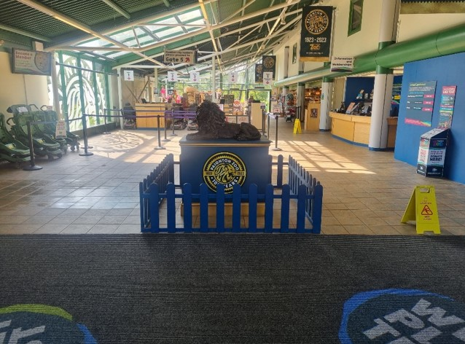
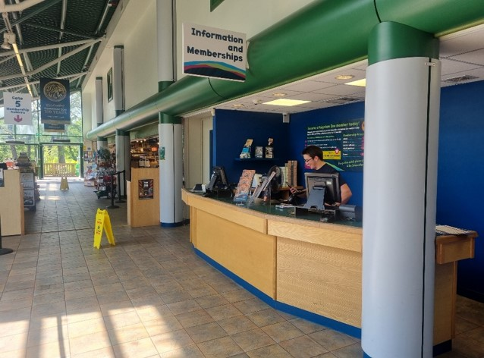
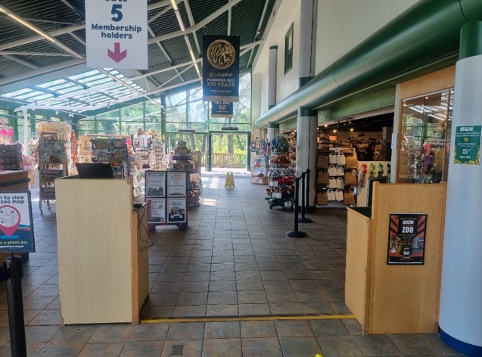
This is inside the entrance building. It can get quite busy in here.
Your group will check in here at the info desk.
You will then walk through gate 5, towards the doors at the end of the building.

Slide 8
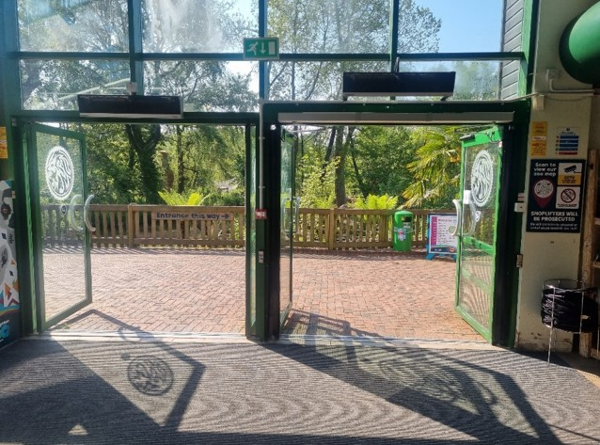
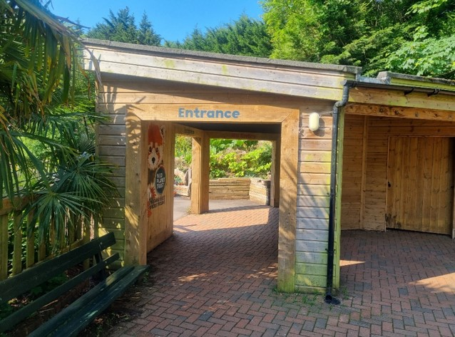
Walk out of these doors and turn right.
Then walk through the archway and enjoy your day at the zoo!

Slide 9
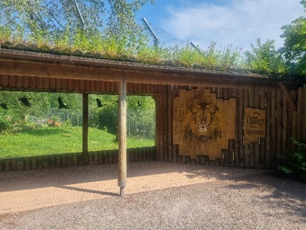
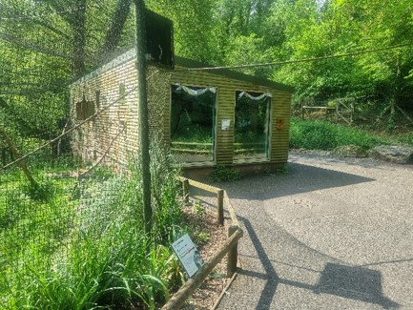
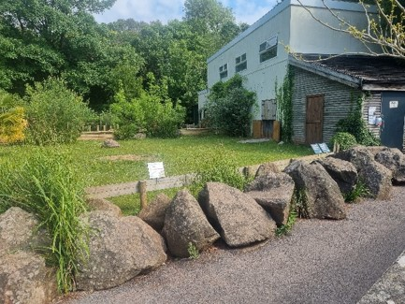
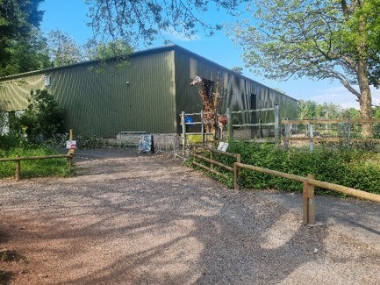
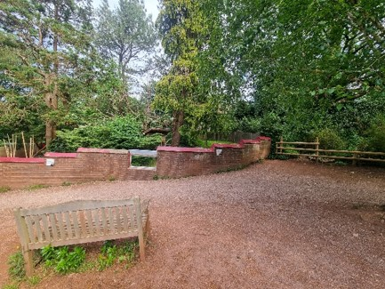
Mini session location
If your group is taking part in a mini session, one of our educators will meet you at an enclosure, tell you some interesting facts and show you some artefacts.
Lion
Lemur
Giant tortoise
Giraffe
Red panda

Slide 10
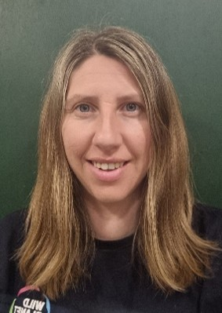
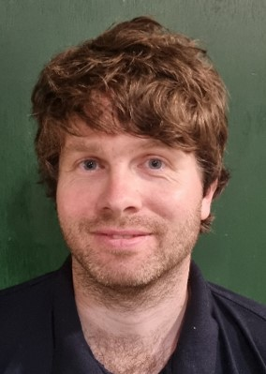
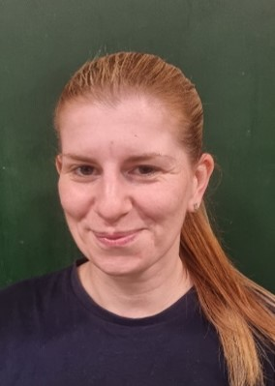
Here are our educators…
Kay
Jason
Nicky
You may meet some of these people on your visit

Slide 11
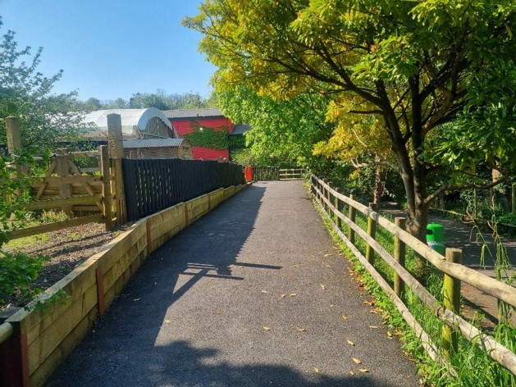
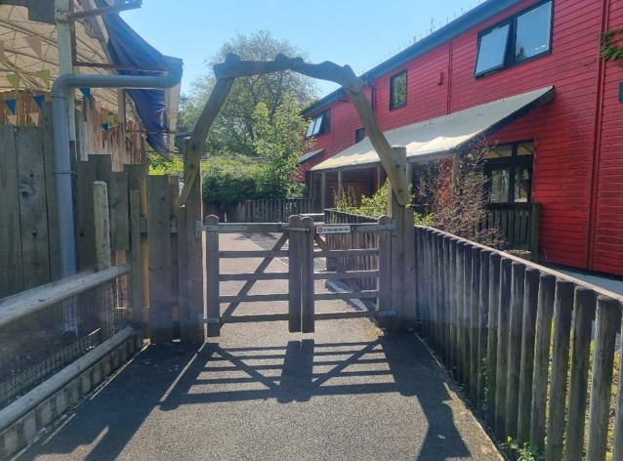
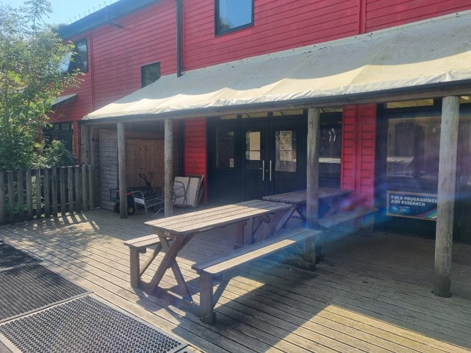
Workshops
If you are attending a workshop, you will visit our education centre.
This is the path to the education centre.
You will go through these gates.
Then one of our teachers will meet you here.

Slide 12
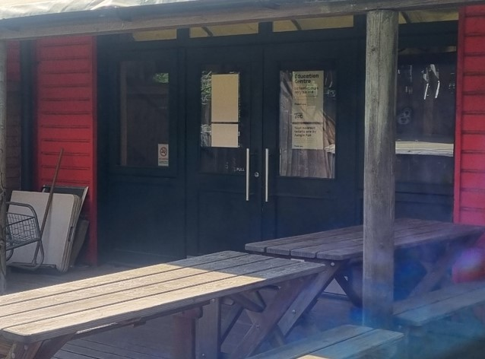
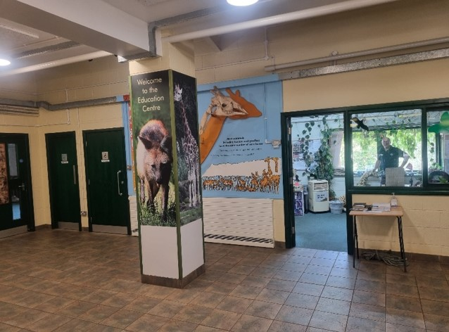
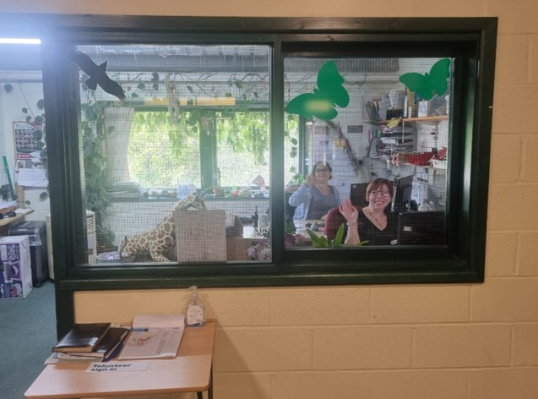
You will go through the entrance of the building.
This is what the foyer looks like.
You may spot people working in some of the other rooms.

Slide 13
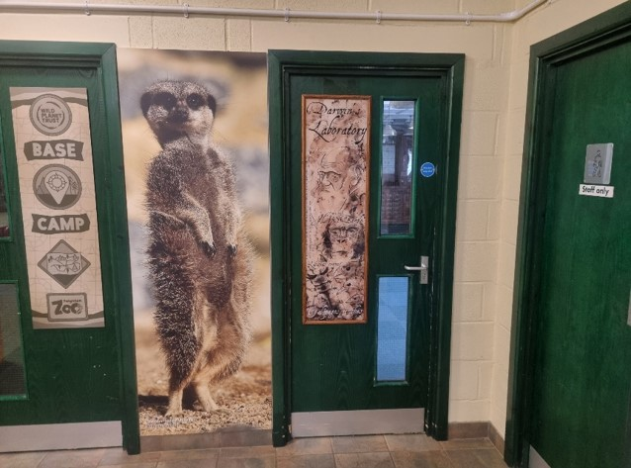
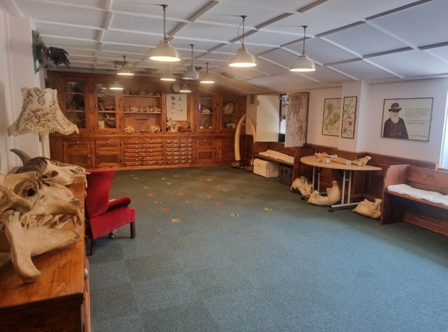
This is the entrance to Darwin, our classroom.
This is inside Darwin. You will sit down on the carpet to start.

Slide 14

Our teacher
Kay
Our teacher will lead the workshop.

Slide 15
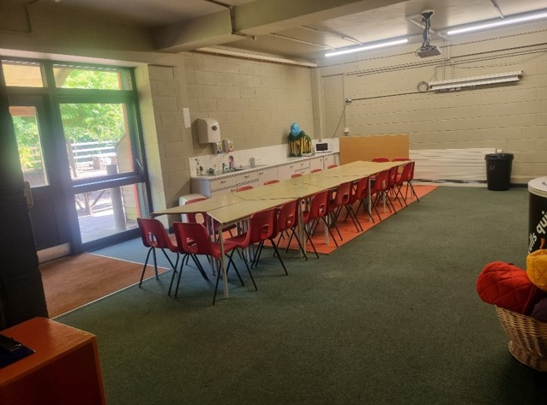
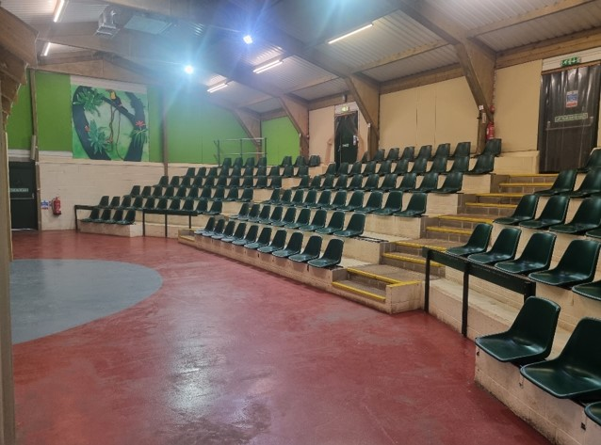
Lunch Space
Base Camp
Motobo
Our lunch spaces, provide somewhere dry for you to eat your lunch and they are exclusively for school groups. If we are busy, You might have to share with another school.

Slide 16
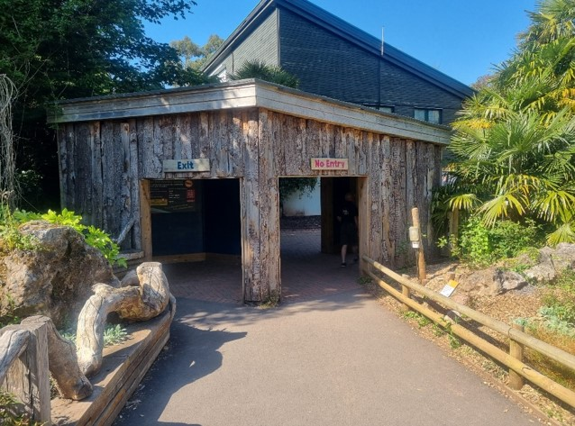
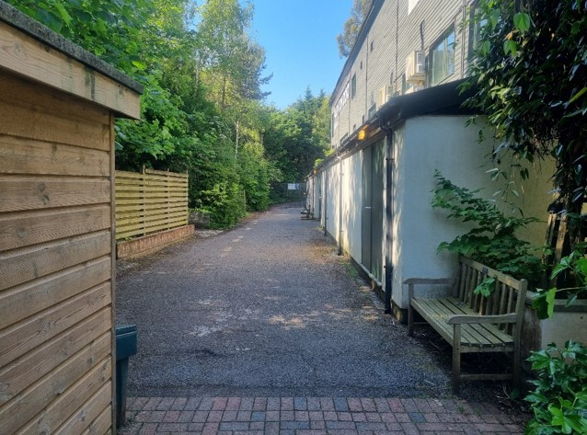
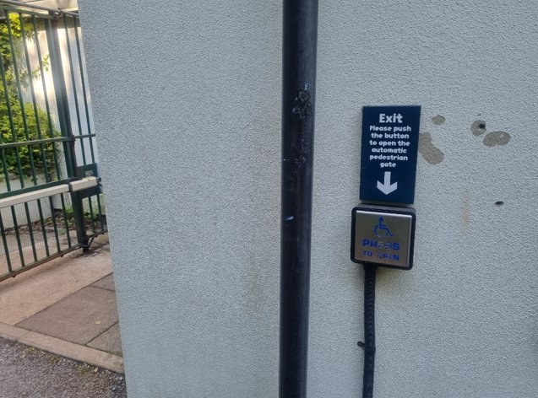
Departure
(Avoiding gift shop).
You will leave the zoo, the same way you came in.
Through the arch way pass the rhino’s bum.
Walk towards the green gate.
On the wall near the gate there is button to push.

Slide 17
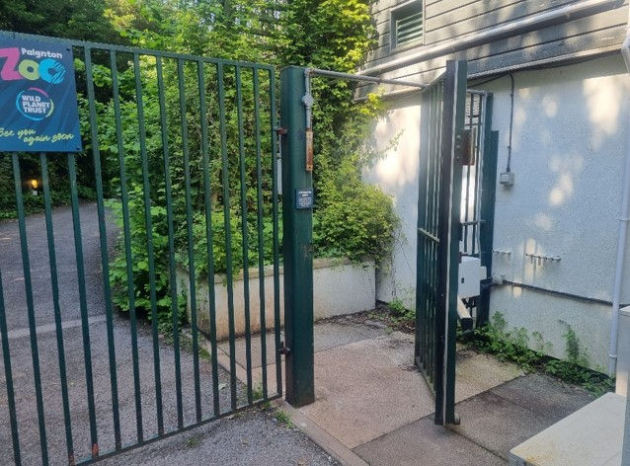
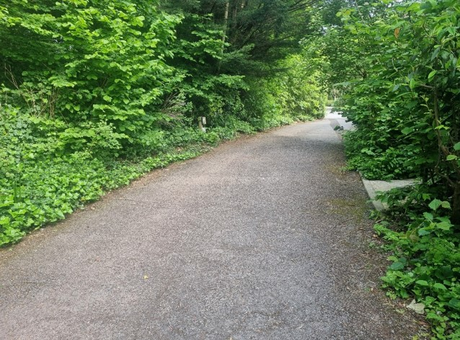
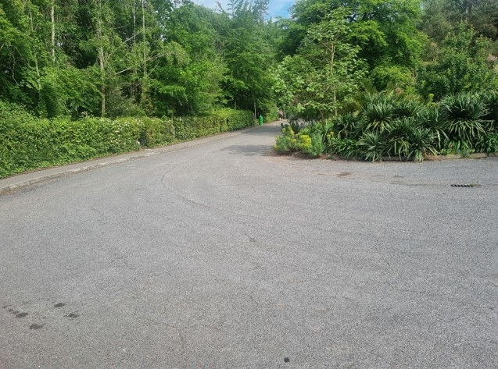
The button opens the small gate.
Walk down the drive.
Your coach or minibus will be waiting at the entrance.

Slide 18
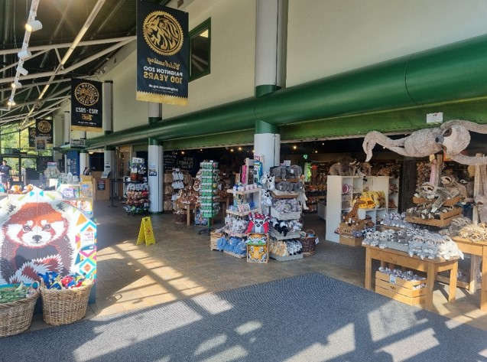
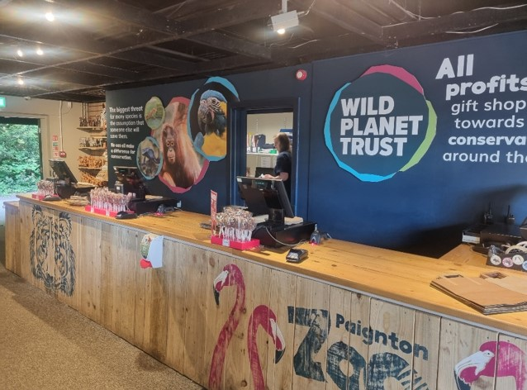
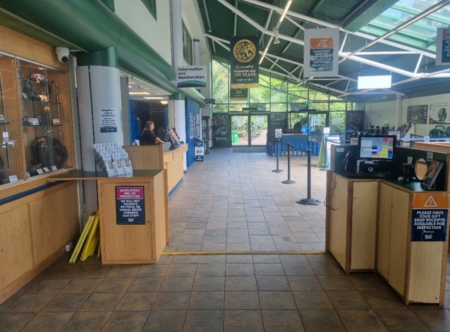
Departure
(Including gift shop)
This is the gift shop. There are lots of things to look at and that you can buy.
You pay for your things at these tills.
To leave the zoo, walk through the exit gate.

Slide 19
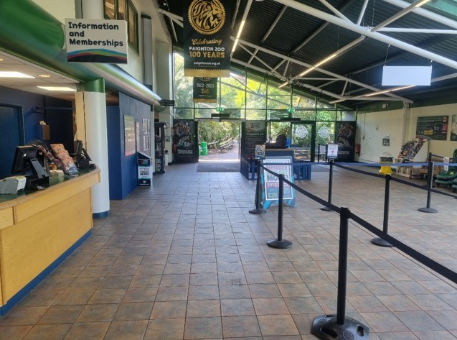
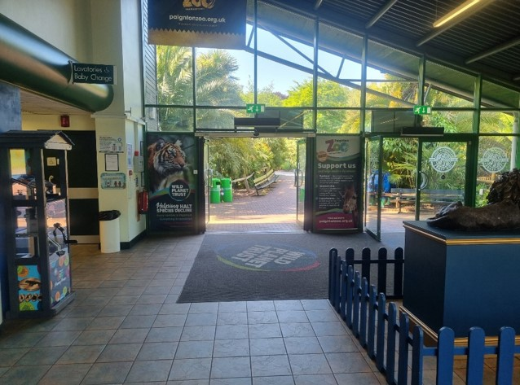
Keep walking towards the doors.
Then out through the main door.
Your coach or minibus will be waiting at the entrance.

Slide 20
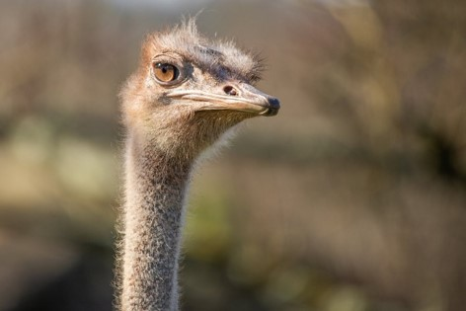
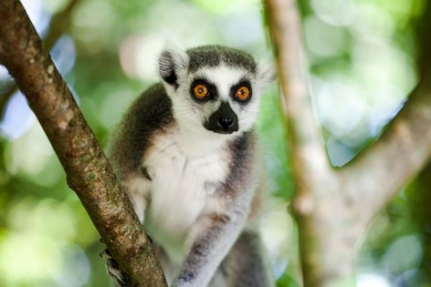
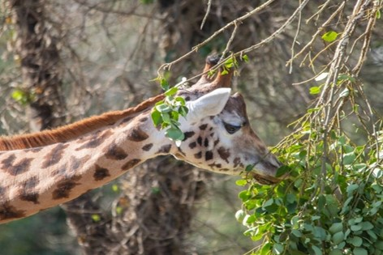
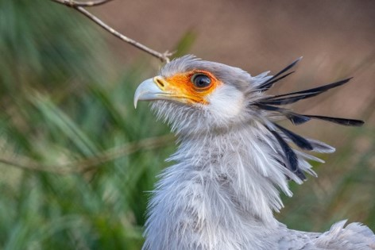
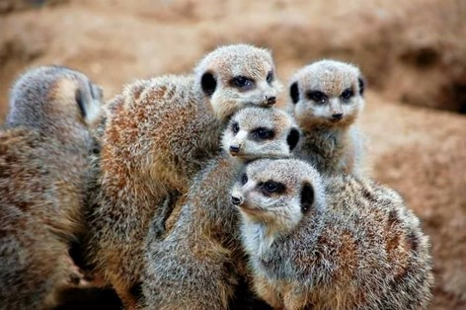
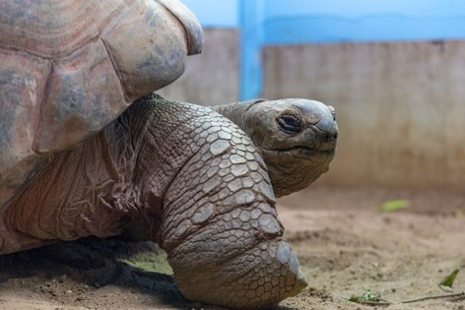


Some of our animals

Slide 21
We will see you soon!

